Slide 1
The Role of Health Centers in Reducing the Burden of Radon-Induced Lung Cancer: Part 2
January 28th, 2025 | 3 pm EST

Slide 2
Part 2: Discover how a public housing-focused health center successfully conducts radon testing, prevention, and patient education to protect vulnerable communities
January 28th, 2025 - 3 pm EST

Slide 3
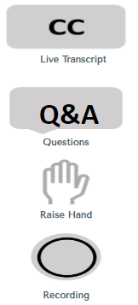
Zoom Orientation
1
Captions
To adjust or remove captions, click the “Live Transcript” button at the bottom of your Zoom window and select “Hide Subtitle” or “Show Subtitle.”
2
Questions
Please add your questions for the speaker in either the Q&A tab or in the Chat box.
3
Technical Issues
Please message us in the chat.
4
Recording
This session will be recorded and made available to participants.

Slide 4
Please say Hi in the chat and enter your name, credentials location, role and….
ICE BREAKER QUESTION
Notes:
mentimeter:
Pre-Session Poll: Use multiple-choice or ranking questions to gauge participants' prior knowledge or expectations about the topic.
“What aspect of care planning do you find most challenging?”
Word Clouds: Ask participants to share one word that describes their biggest obstacle in care coordination.

Slide 5
The National Nurse-Led Care Consortium (NNCC) is a nonprofit public health organization working to strengthen community health through quality, compassionate, and collaborative nurse-led care.
NNCC’s mission is to advance nurse-led healthcare through policy, consultation, and programs to reduce health disparities and meet people’s primary care and wellness needs.
We do this through:
training and technical assistance
public health programing
consultation
direct care
The NNCC NTTAP is funded by HRSA’s Bureau of Primary Health Care to provide subject matter expertise through the development, delivery, coordination, and evaluation of FREE training and technical assistance offerings to health center grantees and look-alikes.
This program is supported by the Health Resources and Services Administration (HRSA) of the U.S. Department of Health and Human Services (HHS) as part of an award totaling $550,000 with 0 percent financed with non-governmental sources. The contents are those of the author(s) and do not necessarily represent the official views of, nor an endorsement by, HRSA, HHS, or the U.S. Government.
Notes:
Script:

Slide 6
Accreditation Statement
Accreditation Statement: The National Nurse-Led Care Consortium is accredited as a provider of nursing continuing professional development by the American Nurses Credentialing Center’s Commission on Accreditation. Each session has been approved for 1.0 NCPD contact hours.
Success Completion Requirements: To obtain 1.0 contact hours of nursing continuing professional development, you must participate in the entire activity, complete the evaluation, and achieve an 80% pass rate on the knowledge gain assessment following the session.
Notes:
At end of zoom you will have a choice to leave Zoom to answer the eval.

Slide 7
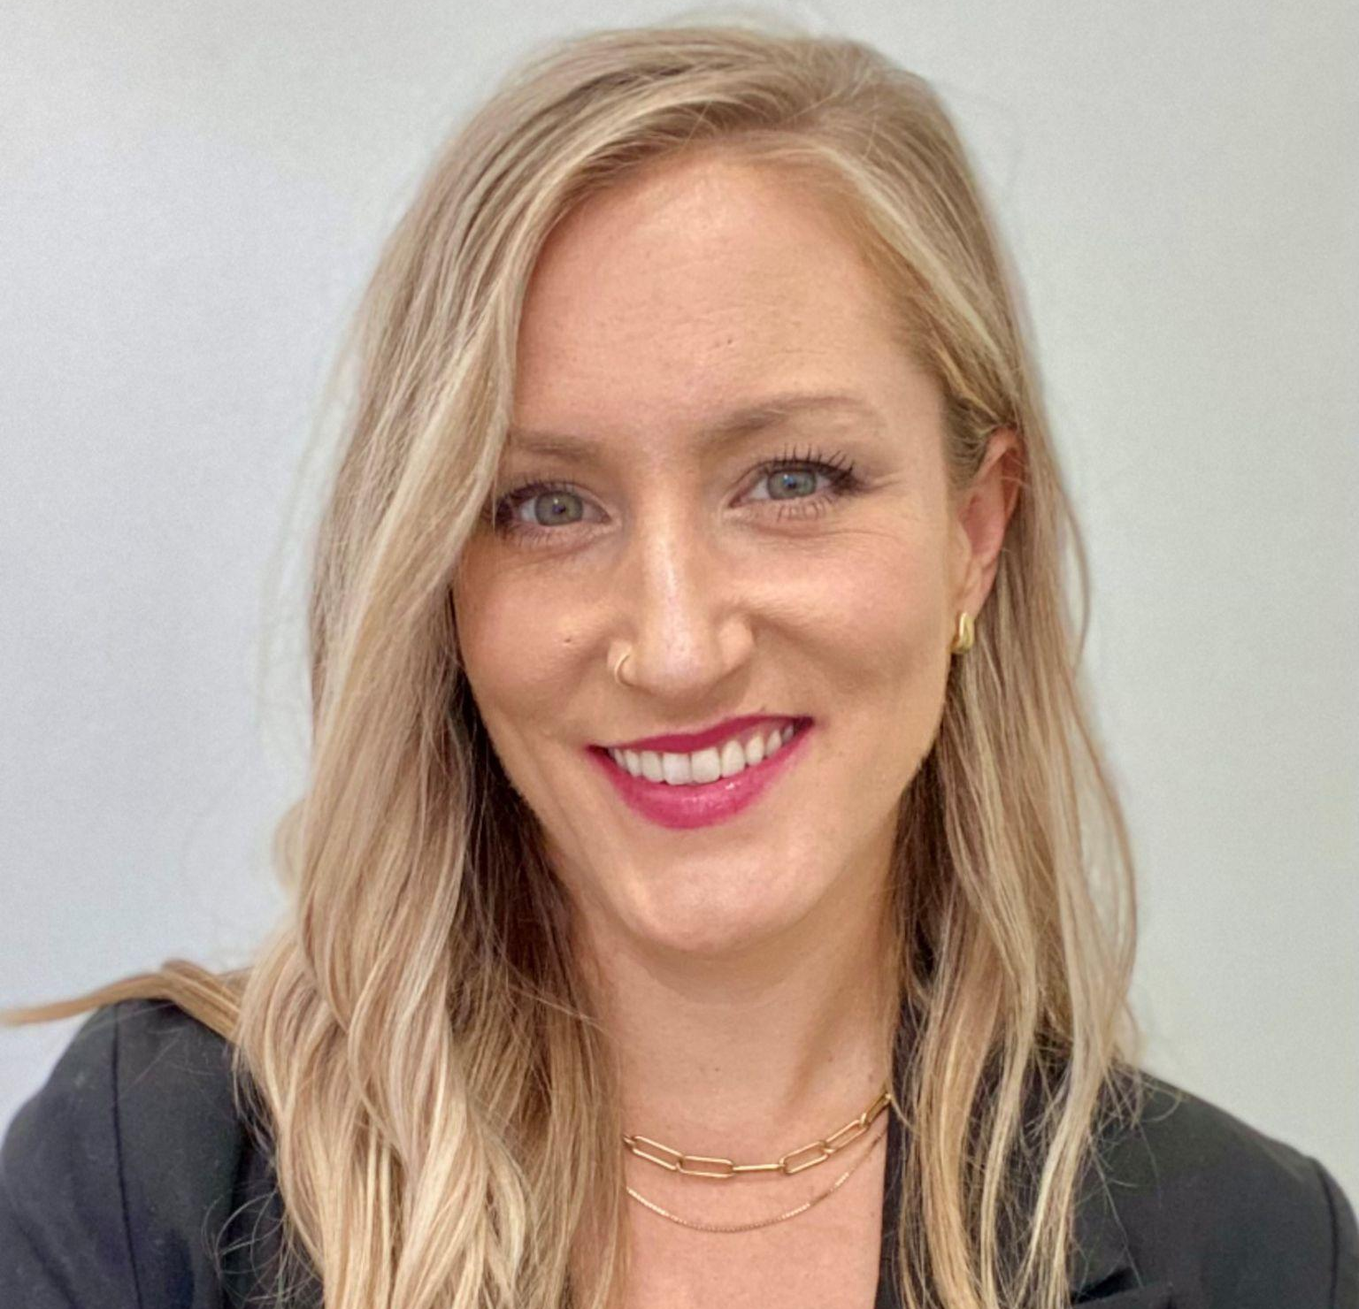
NNCC NTTAP
Jillian Bird, MS, RN
Director of Training and Technical Assistance
Matt Beierschmitt, MPP
Senior Program Manager
Fatima Smith, MPH
Project Manager
Mekenzie Williams, BSN, RN, ACC
Nurse Training Manager
Regina Brecker, MPH
Project Coordinator
Junie Mertus, Program Intern

Slide 13
Today’s Agenda
5 min - Introduction/Welcome
25 min - Robert K. Lewis
Radon Program Manager PA DEP/Bureau of Radiation Protection
25 min- NCHPH Team- Case Study
Dr. Kevin Lombardi, MD, MPH
Bob Burns, MPA
5 min - Questions & Wrap-Up

Slide 14
Subject Matter Experts
Kevin Lombardi, MD, MPH | Director of Research
The National Center for Health in Public Housing (NCHPH)
Robert K. Lewis|Radon Program Manager
PA DEP/Bureau of Radiation Protection

Slide 15
National Nurse-Led Care Consortium
Protecting Vulnerable Communities
January 28, 2025
Josh Shapiro, Governor
Jessica Shirley, Interim Acting Secretary

Slide 16
Radon Characteristics
Naturally Occurring
Colorless, Odorless, tasteless
Gaseous
Radioactive
Notes:
‹#›

Slide 17
Pennsylvania and Radon
Blue bar appears on all text pages unless using a chart or large graphic
Slightly enriched Uranium and Thorium in soil and rocks
Minimal glaciation
Ideal amount of rain fall
Significant amount of limestone soils
Place DEP logo with left keystone in bottom right corner on all pages except cover, final page or when using a chart or large graphic.
Notes:
‹#›

Slide 18
Radon Testing
Blue bar appears on all text pages unless using a chart or large graphic
40% of PA test results Are greater than 4 pCi/L
~6,000 test results greater than 100 pCi/L
Every county affected to greater or lesser extent.
12.5 million people
Place DEP logo with left keystone in bottom right corner on all pages except cover, final page or when using a chart or large graphic.
Notes:
‹#›

Slide 19
Radon Testing
PA DEP recommends that all homes, schools, and businesses/buildings test for radon.
U.S. EPA Guideline is 4 picoCuries/liter (pCi/L)
The only way to know is to Test.
Notes:
‹#›

Slide 20
Health Concerns
Only known health effect is lung cancer.
Long-term exposure required
Class A carcinogen
Notes:
‹#›

Slide 21
Health Concerns
1995 157,400 people died of lung cancer (LC), all causes.
Radon central estimate 15,000-22,000 LC deaths/year.
Most radon induced lung cancers occur in smokers
Notes:
‹#›

Slide 22
Radon Mitigation
Hire a state certified radon mitigation contractor.
In your own home, do the work yourself.
Typical cost ~ $800 to $1200
Notes:
‹#›

Slide 23
Radon Mitigation System

Slide 24
Radon Mitigation System

Slide 25
Vulnerable and Environmental ustice Justice e
Blue bar appears on all text pages unless using a chart or large graphic
Difficult situation
Testing costs~ $20-$30, Mitigation costs ~ $1,000.
I still encourage testing. There are things that one can do.
Notes:
‹#›

Slide 26
Robert Lewis, PA DEP, Bureau of Radiation Protection, Radon Division 717 783-9485 rolewis@pa.gov
No DEP logo when using graphic header

Slide 27
Subject Matter Experts
Kevin Lombardi, MD, MPH

Slide 28
Identifying Radon Exposure in Complex Patients
Dr. Kevin Michael Lombardi MD, MPH
Director of Research The National Center for Health in Public Housing North American Management
--

Slide 29
Case Study: Radon Exposure
Mr. Thomson is a 57 year-old man who presents for a wellness exam at his Health Center. He has a past medical history of COPD and hypertension. The patient has a behavioral health history of Major Depressive Disorder (MDDs), Generalized Anxiety Disorder (GAD) and Tobacco Use Disorder (20 pack years in 2022).
Past medical records indicate the Mr. Thomson has struggled significantly with headaches, mental health and tobacco use since moving into his HUD-supported housing in 2022, with these becoming worse after his diagnosis with COPD in October, 2023.
Due to his COPD, Mr. Thomson is oxygen-dependent (2 lpm) and struggles walking up the stairs or down the street without loosing his breath.
Notes:
Note on how important case studies are to understanding patient care and program management

Slide 30
Case Study: Case Study: Radon Exposure
The patient undergoes a standard intake, including vitals and an SDOH screener. The results are as follows:
BP: 178/98
HR: 92
RR: 18
A review of Mr. Thomson’ medical records indicates the following:
Vitals (2018):
BP: 138/98
HR: 60
RR: 26
HbA1c: 7.0 Prescribed Medications: Chlorothiazide, Citalopram (Celexa)
Drug Screen: Pan-negative
Notes:
Disability 1st and second floor must be checked – basement apartment –
Deteriorated – patient is only taking ½ dose.

Slide 31
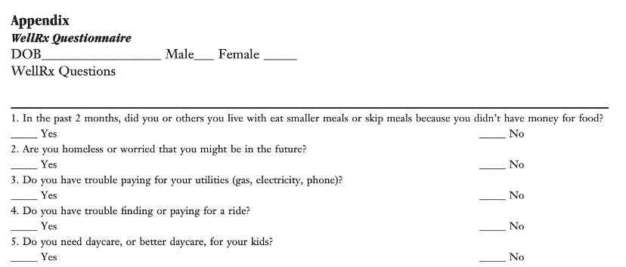
Case Study: Case Study: Radon Exposure
Link: To Resource
Notes:
Whitney Wright

Slide 32
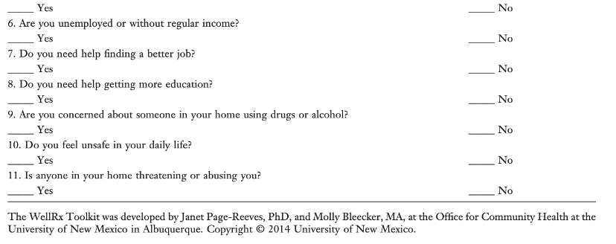
Case Study: Case Study: Radon Exposure
Link: To Resource

Slide 33
Case Study: Case Study: Radon Exposure
Mr. Thomson is treated by his provider. Upon physical examination the following is determined by his provider:
Mr. Thomson is noted exhibit a barrel chest and posturing while sitting.
He struggles to breathe as he speaks, even while on oxygen.
He is unable to walk to the door of the exam room without his oxygen.
While on oxygen he is able to walk down the hall without loosing his breath.
His spirometry is consistent with moderate-severe COPD (GOLD 3)
Notes:
Information on welders – importance of knowing about patient occupations – a lot about their life and their risks for disease injury and chronic illness
Unemployment – impact on patients – budgets go down quickly and there is a lot of stress to get employed – drivers for depression drug use, relapse abuse etc etc etc
20% disability 338.49 per month
This patient needs to be asked about his adverse military. Experiencess
Talk about legality of apartment
Smoking – this patient needs smoking remdiation – this patient should receive resouurces – education mention the interplay between – patint talkls about the different riiskk factors in his life

Slide 34
Case Study: Case Study: Radon Exposure
When Questioned Regarding the Results of His SDOH Screener Mr. Thomson Reveals the following:
He worked as a welder until 3 months ago when he was laid off. He has 2 months of unemployment available.
He is behind on his utilities and his truck is unreliable. He uses uber for transportation.
Mr. Thomson reports more frequent “panic attacks” in the past six months (3 x per week vs 1x per month one year ago)
Mr. Thompson lives with his wife and three children, all of whom have “asthma”.
Mr. Thompson lives in a well-insulated basement apartment. The home was built in 1968.
Mr. Thomson receives a 20% disability payment from the US Army every month.
Mr. Thomson has been taking a half dose of his prescription medications because he can no longer afford the medication.
Notes:
Information on welders – importance of knowing about patient occupations – a lot about their life and their risks for disease injury and chronic illness
Unemployment – impact on patients – budgets go down quickly and there is a lot of stress to get employed – drivers for depression drug use, relapse abuse etc etc etc
20% disability 338.49 per month
This patient needs to be asked about his adverse military. Experiencess
Talk about legality of apartment
Smoking – this patient needs smoking remdiation – this patient should receive resouurces – education mention the interplay between – patint talkls about the different riiskk factors in his life

Slide 35
Case Study: Case Study: Radon Exposure
Mr. Thomson lives in a basement apartment and lives in a home that may have high levels of Radon and lead exposure
Mr. Thomson is unable to attend usual social events and visit family/friends due to his health
Mr. Thomson worked as contractor, he is eligible for VA benefits but is unsure what is available to him or how to access benefits.
Mr. Thomson has a High School education and has struggled to retrain for new jobs
Mr. Thomson is unable to work and depends on his Army disability for income
Notes:
Wife with a smoking history ass welll

Slide 36
Identifying radon exposure risk
Please take a moment to type your response to the following:
After speaking with a CHW Mr. Thomson expresses interest in quitting smoking and having his home checked for Radon levels
What are your next steps?
What systems does your organization have to support patients like Mr. Thomson in wellness efforts.
‹#›

Slide 37
SDOH Screening, Patients with disabilities
Intake
Consultation
Follow-up engagement
Screener
Screener
Notes:
Describe workflow example

Slide 38
SDOH Screening, Patients with disabilities
Intake
Goal Setting
Follow-up engagement
Relationship building
Screening
Networking.
Goals set during SDOH Screening.
Keeping focus on goals.
Encouragement and networking.
Navigation
Coaching
Case Closure
Relationship building,
Screening
Networking.
Relationship building
Screening
Goal achievement.
Closure when all goals are achieved.
Notes:
Describe workflow and responsibilities of CHW within scope of the case study

Slide 39
Promising practices: patients with disability
Health Centers utilize a variety of promising practices to support better outcomes in patients with chronic conditions
Investing in transportation access is among the most cost-effective interventions used by Health Centers
Many Health Centers have pursued partnerships with local organizations as a cost-effective manner of improving nutrition access
Home safety checks are utilized to lower fall risk for older adults who experience disability and/or chronic disease.
‹#›
Notes:
Describe promising practices

Slide 40
Promising practices: patients with disabilities
Health Centers Utilize Home Visitation to improve patient and community health in a variety of areas
FQHCs have utilized CHWs and LPNs to perform home visit follow-ups for newly diagnosed Congestive Heart Failure
Nurse-led home visits are used by Health Centers to improve Hypertension self-management in older adults.
Long-acting Injectable antipsychotics are associated with a 71% of hospital admissions. Health Centers utilize RNs and advanced providers to provide these via home-visit.
‹#›
Notes:
Describe promising practices

Slide 41
Questions?

Slide 42
Evaluation Survey
Notes:
Wrap up:
As a reminder before we sign off, please take some time to complete the post-webinar survey. The feedback you provide is SO VERY HELPFUL in guiding our training content and future planning. and If you are getting contact hours for today's learning activity follow the links to the quiz. And look for your certificate in about 2 weeks.

Slide 43
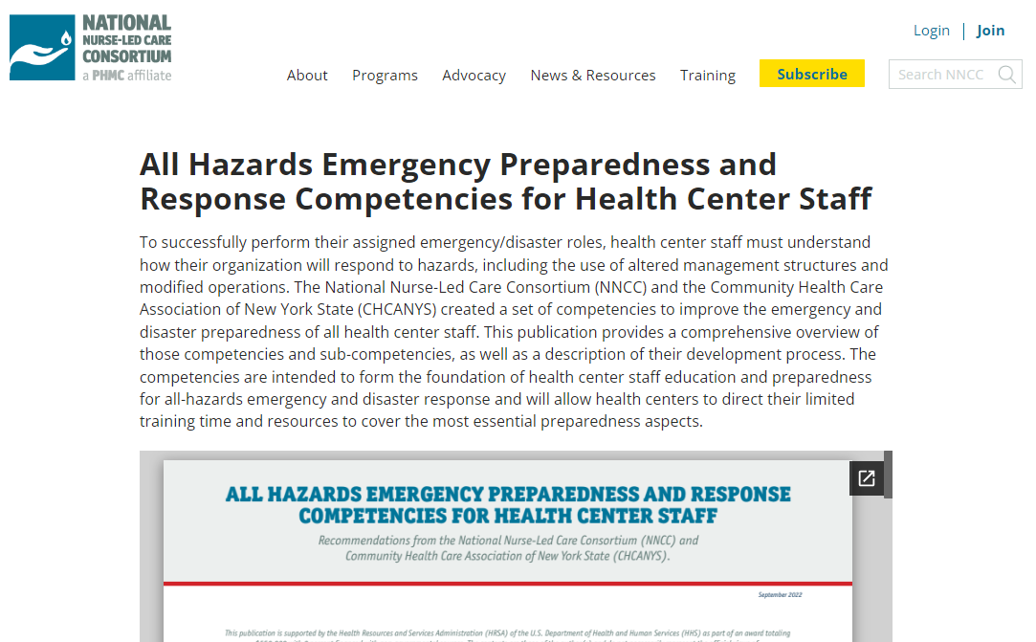
Access Health Center Resources
NNCC Resource Library
Notes:
Please

Slide 44
Upcoming Trainings
February 11th & 18th- 3pm EST
Understanding Community Violence as a Critical Factor in Health and Well-Being- 2 part webinar series
Registration: https://us02web.zoom.us/webinar/register/WN_pKRGXNesThiPx1aii0RQ9w
February 19th - 2pm EST
Health Center Preparedness & Response Forum
Registration: https://us02web.zoom.us/webinar/register/WN_RAWRSaX4R-uBZDtpm6rRXw

Slide 45
Thank You!
If you have any further questions
or concerns please reach out to
Fatima Smith fasmith@phmc.org
Subscribe for the Latest Updates
Subscribing to our email newsletter is the best way to learn about all of
NNCC's free webinars and other online learning opportunities.
SUBSCRIBE

